Slide 1
CAPSTONE PROJECT -CAR ACCIDENT SEVERITY
September 2020, ibm data science certificate

Slide 2
The problem
Road accidents are always a serious and frequent issue.
In this project we aim to inform the drivers for the possibility of an accident occurring when there are specific weather, road and visibility conditions, in order to be more prepared.

Slide 3
Data
We use shared data for Seattle city for our project. Data are from 2004 until now (05/2020).
Our dataset has 38 columns and 194.673 rows

Slide 4
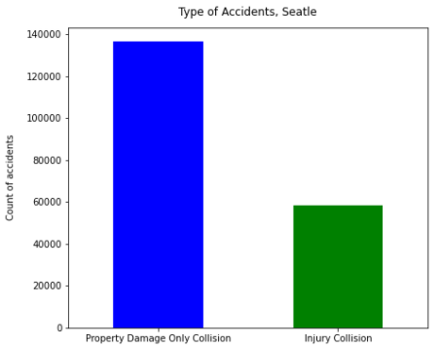
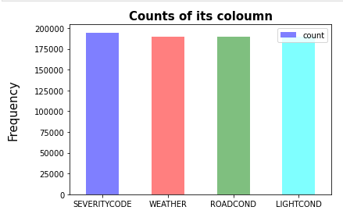
Exploratory Analysis
Graphs for all of ours columns and for our main feature , the severity of an accident.

Slide 5
Machine Learning Model
Different classification algorithms, such as Decision Trees, Logistic Regression and KNN (k-Nearest Neighbor) were used in order to predict the severity of an accident based on the selected features.
The Support Vector Machine (SVM) was not used due to the size of dataset.
Various evaluations metrics were used such as Accuracy, F1 Score, Jaccard Index, Precision/Recall score, LogLoss score.

Slide 6
Results by algorithm
Algorithm | Accuracy | F1 | Jaccard Index | Precision/Recall | LogLoss
Decision Tree | 0.69618147 | 0.57150931 | 0.69617344 | 0.69615506
Logistic Regression | 0.69615506 | 0.57144760 | 0.69615506 | 0.69615506 | 0.59545798
KNN (k-Nearest Neighbor) | 0.696023027 | 0.574753254 | 0.691666004 | 0.696145824
Comparing the results of the three algorithms used, it is understood that their performance where almost the same.

Slide 7
Conclusion
The original dataset had 5 values (3—fatality,2b—serious injury,2—injury,1—prop damage,0—unknown).
The distribution of the two values was problematic and the dataset needed to be balanced.
The unknown values of the features that were used were between 7-8% of the total, a considerable percent.
The three algorithms that were used, probably would perform better if the above restrictions did not exist or existed to a lesser extent.

